Slide 1

Laptops

Slide 2
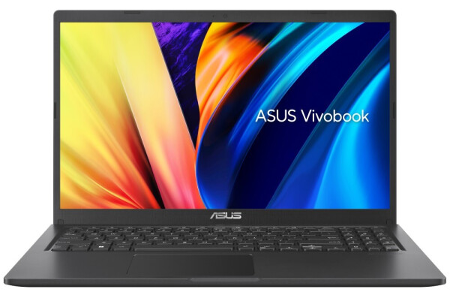
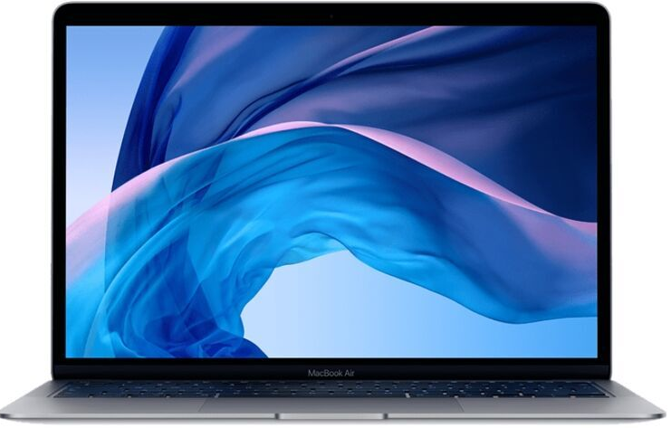
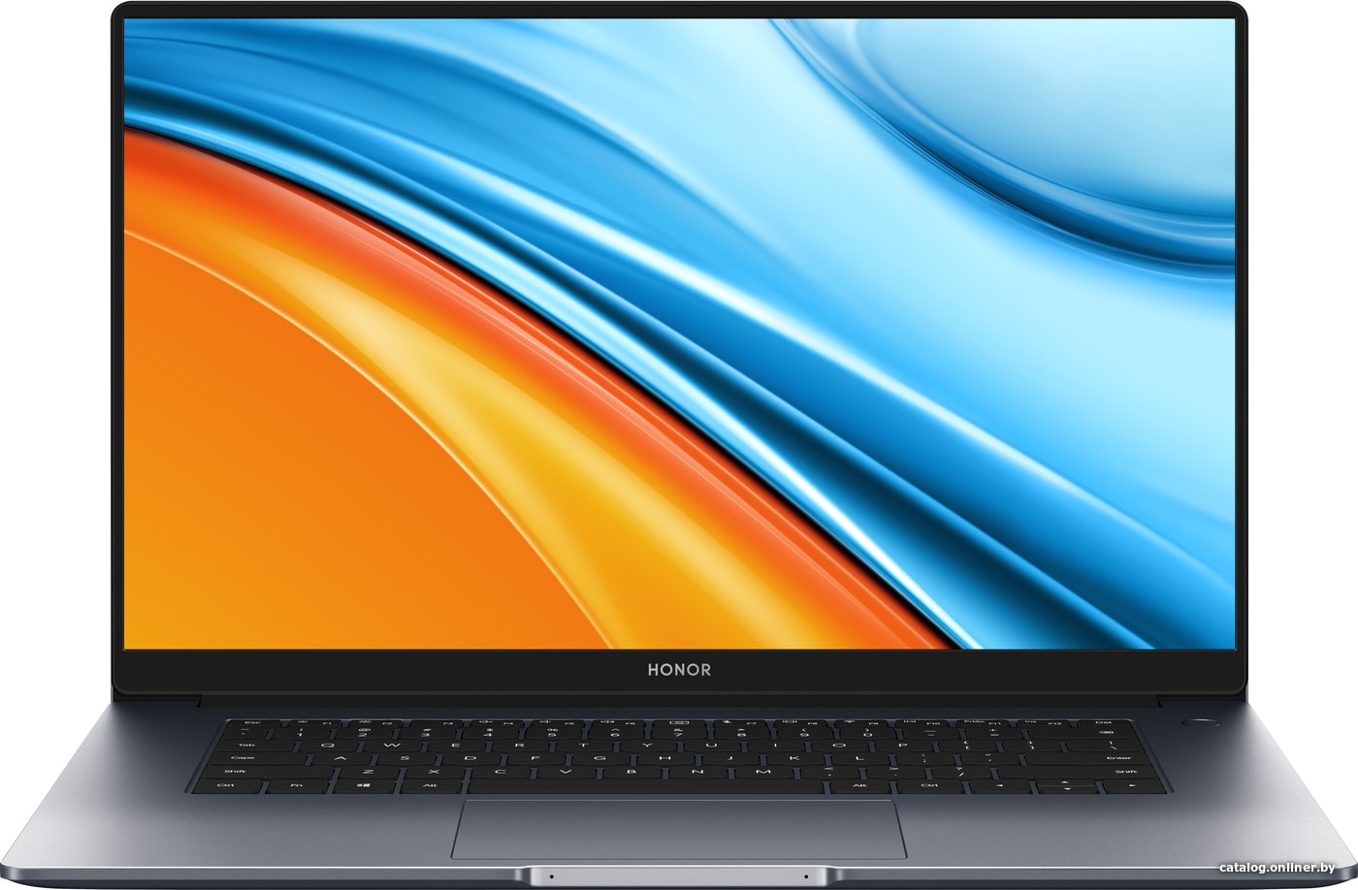
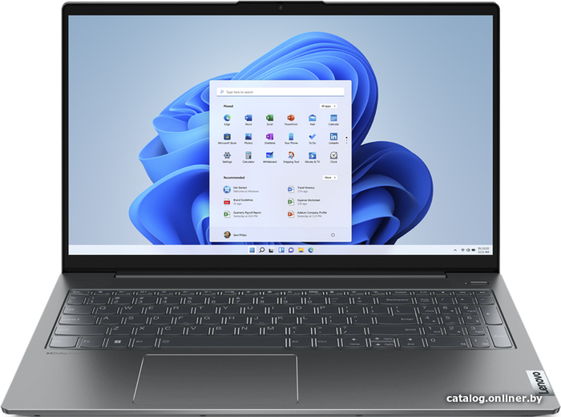
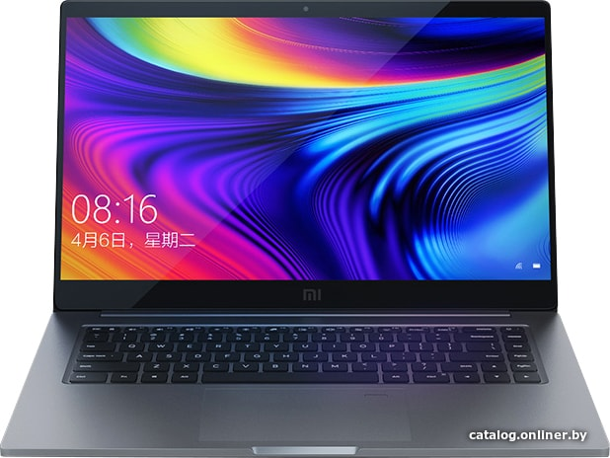
Laptops
ASUS
Apple
Honor
Lenovo
Xiaomi

Slide 3
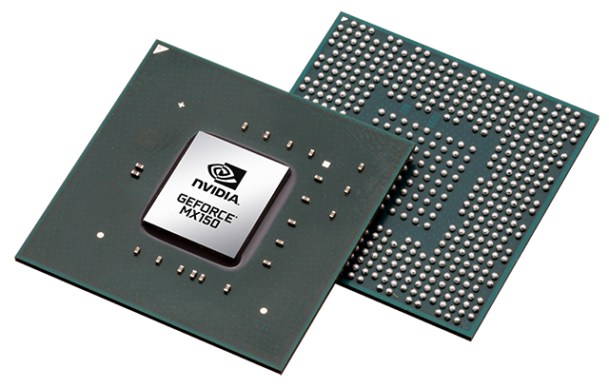
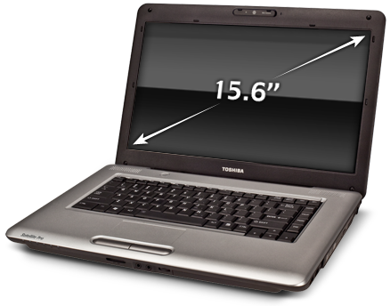
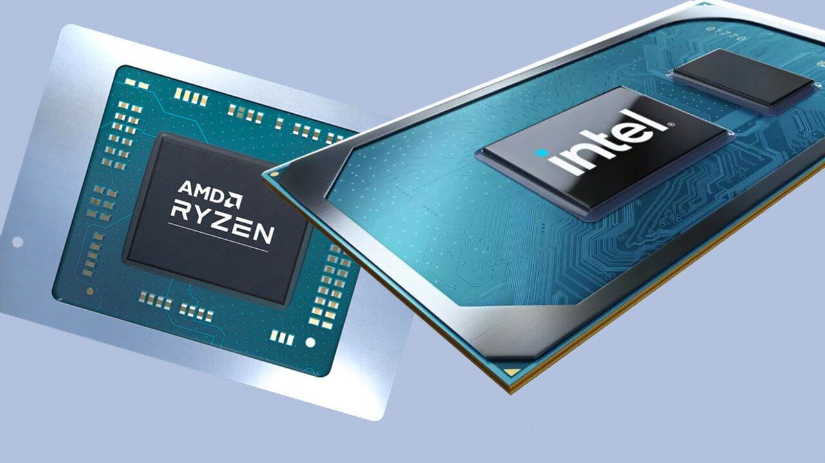
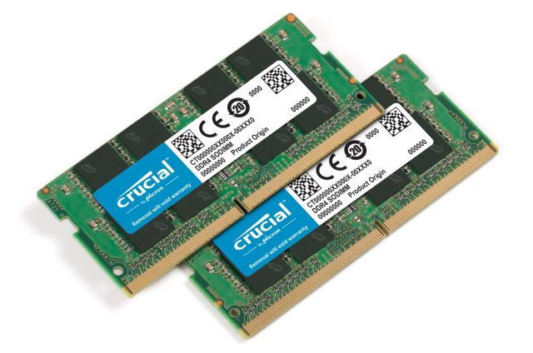
Laptops
Technical characteristics
diagonal
CPU
GPU
Memory

Slide 4
Advantages
Light weight and dimensions
It is not necessary to use external devices to work
Possibility of autonomous work

Slide 5
Disadvantages
The cooling system often fails
Increased chance of crash
Difficulty of repair

Slide 6


Slide 7

Thanks for watching

